Slide 1



Hands-on: Explore data
MiDAS course 2024 - Day 2

Slide 2
Summary from yesterday

Slide 3
Day 2
Beta diversity and functional groups

Slide 4
Beta diversity

Slide 5
Definitions
Beta diversity: sample dissimilarity.
Quantifies differences in the overall taxonomic composition between two samples
Use an index to transform the ASV table → distance matrix
Visualisation of the distance matrix using ordinations plots

Slide 6
Definitions
Beta diversity: sample dissimilarity.
Quantifies differences in the overall taxonomic composition between two samples
Use an index to transform the ASV table → distance matrix
Visualisation of the distance matrix using ordinations plots
Common indices:
Bray-Curtis → relative abundances of species
UniFrac → phylogenetic information
Jaccard index → only presence/absence values.

Slide 7
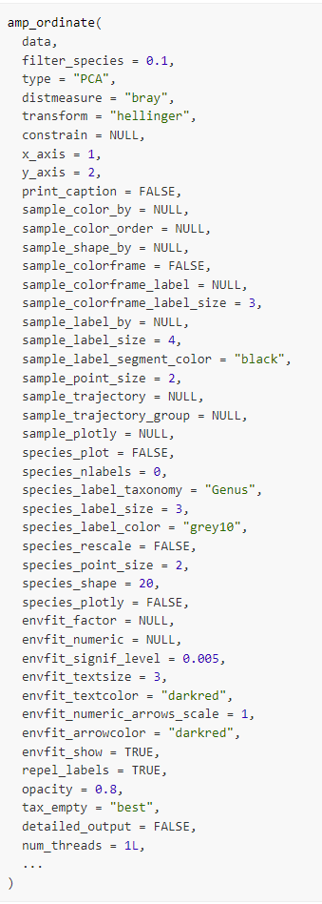
The amp_ordinate() function

Slide 8
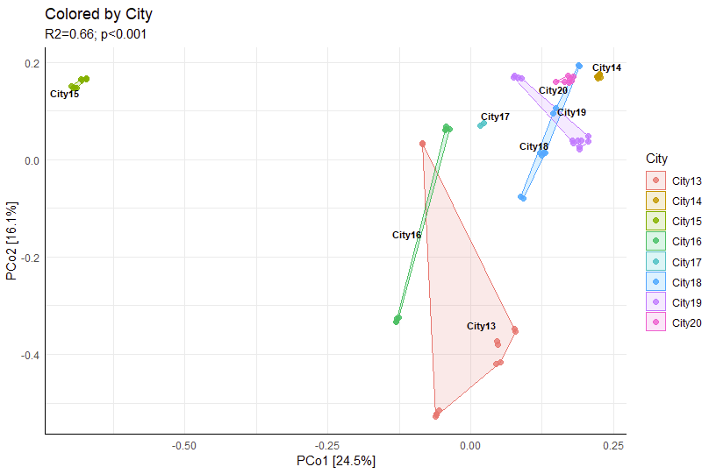
The amp_ordinate() function

Slide 9
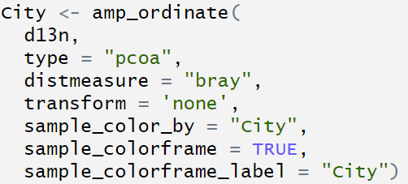
The amp_ordinate() function

Slide 10
The amp_ordinate() function

Slide 11
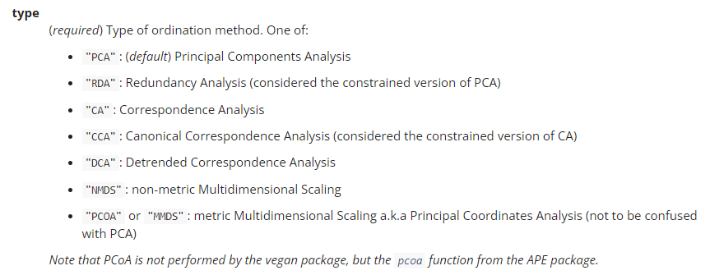
The amp_ordinate() function

Slide 12
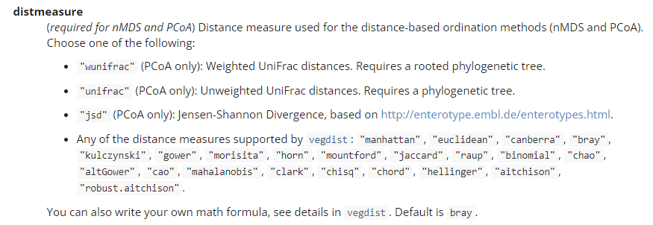
The amp_ordinate() function

Slide 13
Are the groups significant separated?

Slide 14
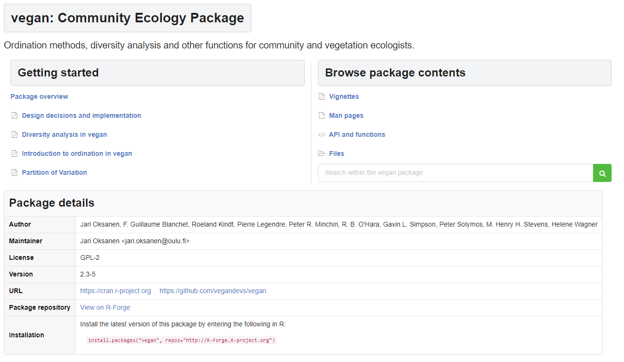
Adonis analysis
Analysis of variance using distance matrices

Slide 15
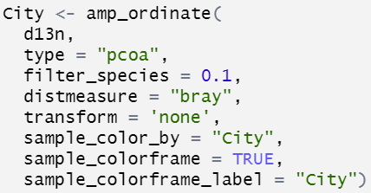
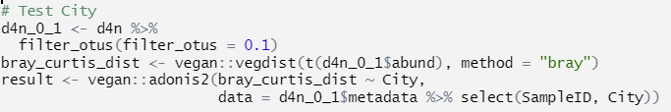
Are the groups significant separated?

Slide 16
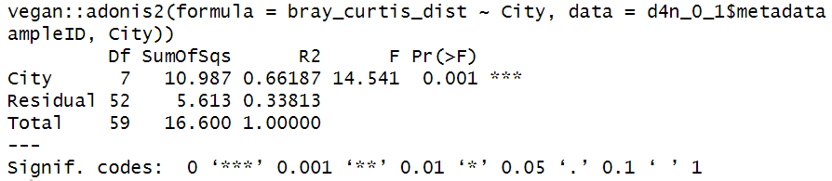
Are the groups significant separated?

Slide 17
Functional groups

Slide 18
Functional groups
Functional groups are available in the MiDAS field guide:
Gordonia: https://www.midasfieldguide.org/guide/fieldguide/genus/gordonia
Anaerobic digesters the most interesting groups are the bacteria involved in:
Syntrophic bacteria
Archaea
Filamentous bacteria - the troublemakers!

Slide 19
Functional groups
Answer the following questions:
Make a heatmap showing the bacteria in each functional group
Are there any of the tanks/cities where they might have foaming problems?
Discuss whether we miss any important groups?

Slide 20

Functional groups - primer bias
Answer the following questions:
Download data using the v4 or v3-5 primerset and redo the analysis :)
If you have your own amplicon data, you can try doing the same analysis

